Slide 1



KHANHCA PAWNSHOP MANAGEMENT SOFTWARE
[SP19-PRO192-SI1301]
Proposed supervisor:
M.Sc. Vo Hong Khanh
Member of Group 11:
Le Quoc Khoi | Leader
CE130023
Nguyen Truong Thinh | Secretary
CE130214
Pham Ngoc Minh Hung
CE130339

Slide 2
OUTLINE
PROBLEM DEFINITION
PROJECT DETAIL
USER REQUIREMENTS
DATA MODEL
CLASS DIAGRAM
DEMO
SUMMARY
Q&A

Slide 3
1 PROBLEM DEFINITION

Slide 4
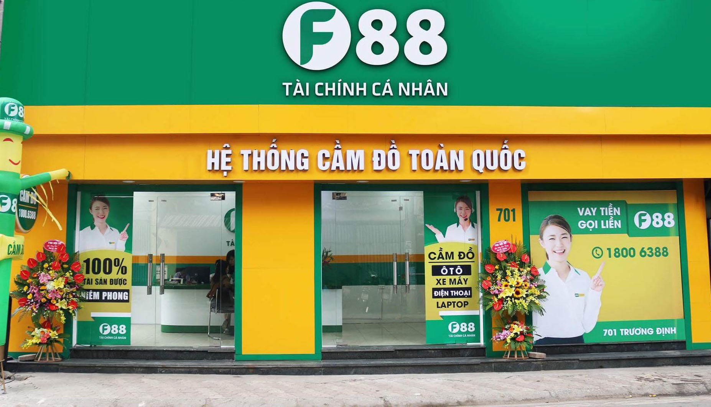
1. PROBLEM DEFINITION
30.000 pawn shops are operating in Vietnam
5% apply technology to their pawn work

Slide 5
BENEFITS
- Accurately calculate complex interest rates, avoid errors in the manual calculation process.
- Managing a large of contracts, avoiding unnecessary errors when managing by notebooks.
- Closely monitor business activities from controlling revenue, expenses, and interest.
- Provide a variety of reports and diverse statistics to help owners quickly make immediate and quick decisions.
- Make multiple contracts simultaneously.
- Help save a lot of time when the software has solved a large amount of work automatically.
- Ensure absolute safety data.

Slide 6
2 PROJECT DETAIL

Slide 7

M.Sc. Vo Hong Khanh
2. PROJECT DETAIL
Client
Address: FPT University, Nguyen Van Cu street
An Binh ward, Ninh Kieu district, Can Tho city.
Email: khanhvohong@gmail.com
Phone number: 0976 755 191

Slide 8
2. PROJECT DETAIL
About us
HKT Group
Address: FPT University, Nguyen Van Cu Noi Dai street,
An Binh ward, Ninh Kieu district, Can Tho city.
Leader: Le Quoc Khoi
Email: khoilqce130023@fpt.edu.vn
Phone number: 0379 168 797

Slide 9
2. PROJECT DETAIL
Date of project plan:
Start: Jan 23th, 2019
End: March 25th, 2019
Project Vision/Objective:
The goal of this project is to improve the productivity of pawn shop staff by using management software.

Slide 10
3 USER REQUIREMENTS

Slide 11
3. USER REQUIREMENTS
- Login to the system must be allowed through login information as username and password.
- Add, view, update, contracts through the contract code, users can change the value of the properties of contract information such as interest rate form, holding amount, start date, holding product information, and customer information.
- Managing the store's cash flow, reporting accurate information on the amount of money pawn to customers.
- Managing customers' assets, reporting assets that have been matured.

Slide 12
4 DATA MODEL

Slide 13
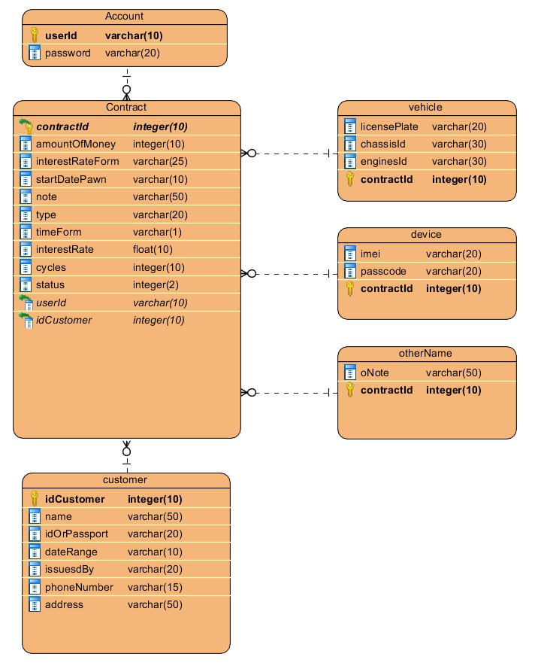
4. DATA MODEL

Slide 14
5 CLASS DIAGRAM

Slide 15
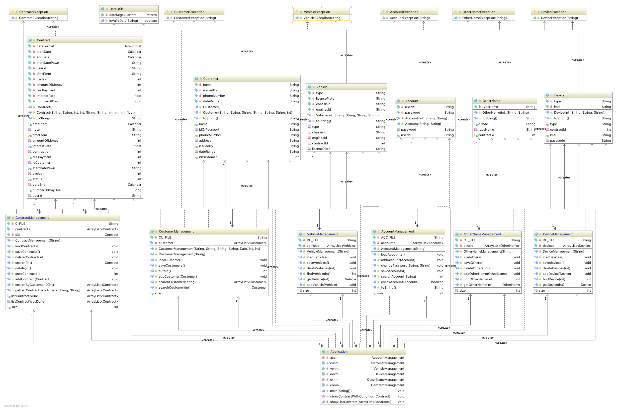
5 CLASS DIAGRAM

Slide 16
6 DEMO

Slide 17
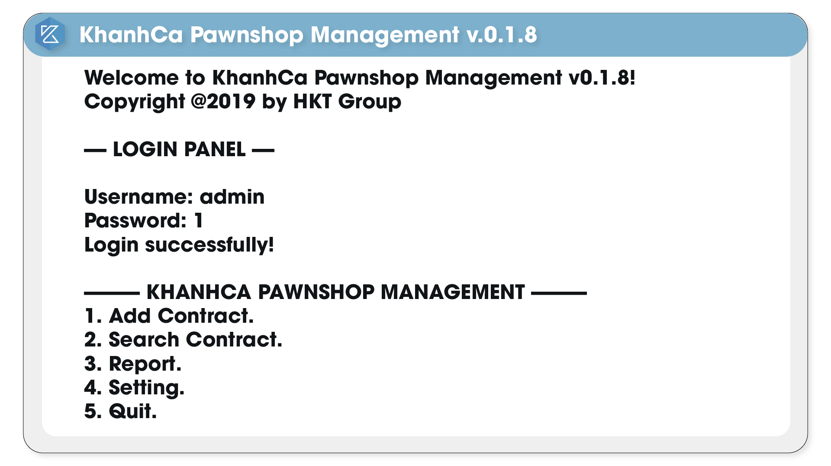
6. DEMO

Slide 18
7 SUMMARY

Slide 19
THANKS!
KHANHCA PAWNSHOP MANAGEMENT SOFTWARE
Any questions?

